Slide 1
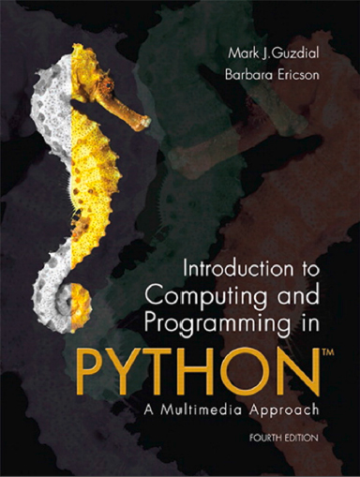
Introduction to Computing and Programming in Python™: A Multimedia Approach
Fourth Edition
Chapter 2
Introduction to Programming
Slides in this presentation contain hyperlinks. JAWS users should be able to get a list of links by using INSERT+F7
Copyright © 2016, 2013, 2010 Pearson Education, Inc. All Rights Reserved
Notes:
If this PowerPoint presentation contains mathematical equations, you may need to check that your computer has the following installed:
1) MathType Plugin
2) Math Player (free versions available)
3) NVDA Reader (free versions available)

Slide 2
Learning Objectives
2.1 To make and show pictures.
2.2 To make and play sounds.
2.3 To use J E S to enter and execute programs.
2.4 To create and use variables to store values and objects, such as pictures and sounds.
2.5 To create functions.
2.6 To recognize different types (encodings) of data, such as integers, floating-point numbers, and media objects.
2.7 To sequence operations in a function

Slide 3


Installation (1 of 2)
Installing J E S and starting it up
Go to http://www.mediacomputation.org and get the version of J E S for your computer.
If you know that you have a Java compiler (e.g., a “J D K” or an “I D E”)
Windows users:
Just copy the folder
Double-click J E S application
If trouble, try jes2.bat or jes-customjava.bat

Slide 4
Installation (2 of 2)
Mac users:
Just copy the folder
Double-click J E S application
There is always Help
Lots and lots of excellent help

Slide 5
Much of Programming is About Naming
We name our data
Data: The “numbers” we manipulate
We call our names for data variables
We name our recipes
Quality of names determined much as in Philosophy or Math
Enough words to describe what you need to describe
Understandable

Slide 6
Naming Our Encodings
We even name our encodings
Sometimes referred to as types
Numbers without decimals are called integers.
Numbers with decimal points are called floating point or floats.
Collections of letters are called strings.
Some programming languages are strongly typed
A name has to be declared to have a type, before any data is associated with it

Slide 7
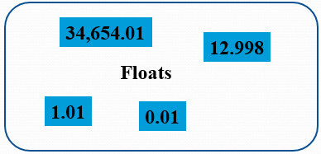
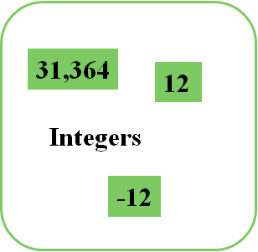
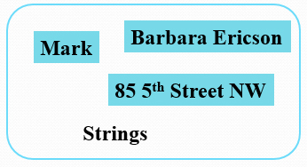
Examples of Types
Inside the computer, these are all just bits

Slide 8
Our Programs Work with a Variety of Names
You will name your functions
Just like functions you knew in math, like sine and gcd (Greatest Common Divisor)
You will name your data (variables)
You will name the data that your functions work on
Inputs, like the 90 in sine(90)
Key: Names inside a function only have meaning while the function is being executed by the computer. (More on this later.)

Slide 9
Names for Things that are not in Memory
A common name that you’ll deal with is a file name
The program that deals with those is called the operating system, like Windows, MacO S, Linux
A file is a collection of bytes, with a name, that resides on some external medium, like a hard disk.
Think of it as a whole bunch of space where you can put your bytes
Files are typed, typically with three letter extensions
.jpg files are J P E G (pictures), .wav are W A V (sounds)

Slide 10
We Will Program in J E S
J E S: Jython Environment for Students
A simple editor (for entering in our programs or recipes): We’ll call that the program area
A command area for entering in commands for Python to execute.

Slide 11
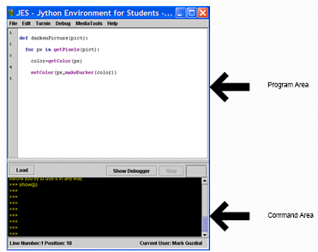
J E S - Jython Environment for Students

Slide 12
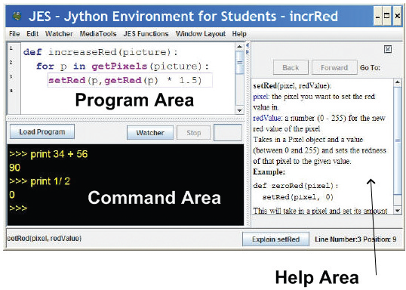
J E S with Help Displayed
Use Window Layout to get the view you want

Slide 13
Tour of J E S
Save and Save As
Cut/Copy/Paste with shortcut keys
Help
If J E S runs slow, close other applications. Web browsers (like Firefox or Internet Explorer) and iTunes and chat tools and… all take up memory. Closing some of them saves memory for J E S.

Slide 14
Python Understands Commands
We can name data with =
We can print values, expressions, anything with print

Slide 15
Names Can Be (Nearly) Whatever We Want
Must start with a letter
Be careful not to use command names as your own names
print = 1 won’t work
Case matters
“Print” is not the same as “print”
“myPicture” is not the same as “mypicture”

Slide 16
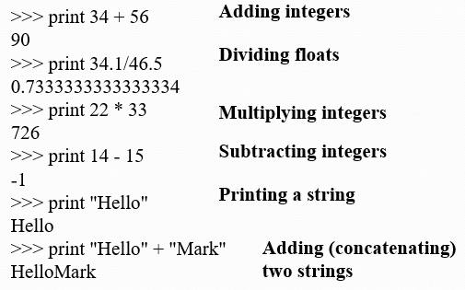
Using J E S

Slide 17
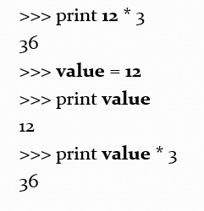
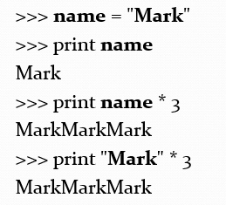
Values and Names with Same Value are Interchangeable

Slide 18
= is Assignment, Not Equality
When you see “=“ in Python, read it as:
“Figure out the value on the right.”
“Give it the name on the left.”
So: size = 12.5
“Figure out the value on the right.” That’s 12.5
“Give it the name on the left.” That’s size
So: total = size * 34
“Figure out the value on the right.” That’s 425 (size * 34 is 12.5 * 34)
“Give it the name on the left.” That’s total

Slide 19
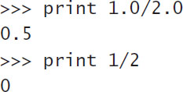
Math May Be Surprising Sometimes
If you only use integers (numbers without decimal points), Jython thinks you only want integers.

Slide 20
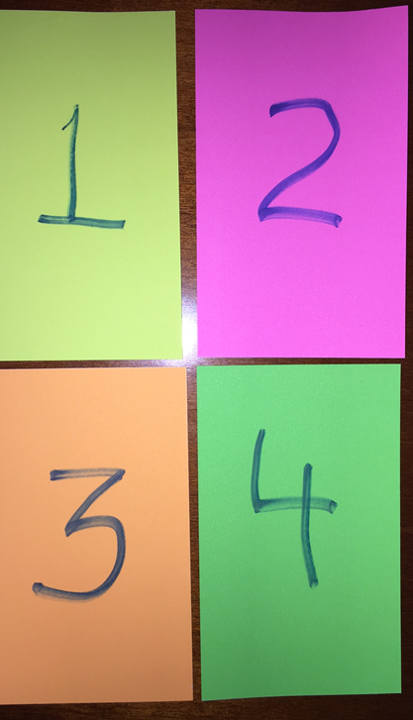
Which One Comes Closest to but Doesn’t Reach 1?
print 4 / 6
print 4 / 6.0
print 4 % 3
print 4 % 3.5

Slide 21
Command Area Editing
Up/down arrows walk through command history
You can edit the line at the bottom
Just put the cursor at the end of the line before hitting Return/Enter.

Slide 22
J E S Functions
A bunch of functions are pre-defined in J E S for sound and picture manipulations
pickAFile()
makePicture()
makeSound()
show()
play()
Some of these functions accept input values

Slide 23
What to do to Show a Picture
Find a file with a picture.
Pick it.
Get the bytes from that file into memory and label it as a type: “picture”
Show the picture

Slide 24
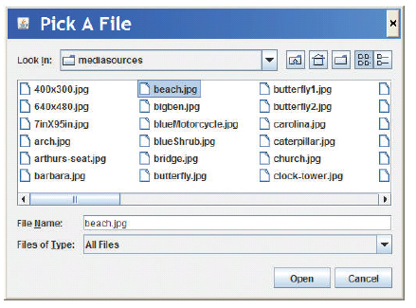
PickAfile() Leads to the File Picker!

Slide 25
Picture Functions
makePicture(filename) creates and returns a picture object, from the J P E G file at the filename
show(picture) displays a picture in a window
We’ll learn functions for manipulating pictures later, like getColor, setColor, and repaint

Slide 26
Sound Functions
makeSound(filename) creates and returns a sound object, from the W A V file at the filename
play(sound) makes the sound play (but doesn’t wait until it’s done)
blockingPlay(sound) waits for the sound to finish
We’ll learn more later like getSample and setSample

Slide 27
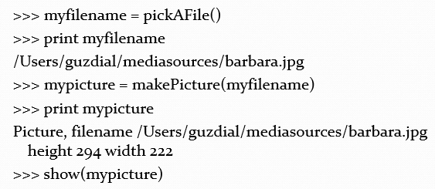
Demonstrating Simple J E S (1 of 2)

Slide 28
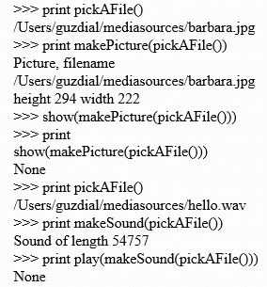
Demonstrating Simple J E S (2 of 2)
pickAFile() returns a filename, which can be used as input to makePicture() to make a picture or makeSound() to make a sound.
Printing a picture just proves there’s a picture there.
show() and play() don’t return anything, so they print None.

Slide 29
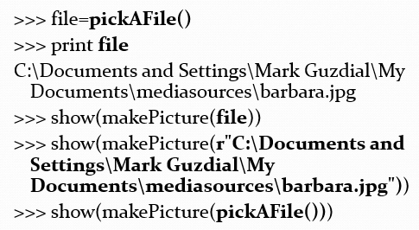
Completely the Same: Values, Names for those Values, Functions that Return those Values

Slide 30
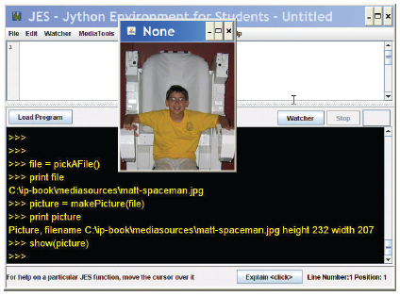
Picking, Making, Showing a Picture

Slide 31
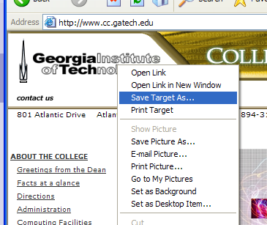
Grabbing Media from the Web
Right-click (Windows) or Control-Click (Mac)
Save Target As…
Can only do J P E G images (.jpe, .jpg, .jpeg)
Most images on the Internet are copyright. You can download and use them for your use only without permission.

Slide 32
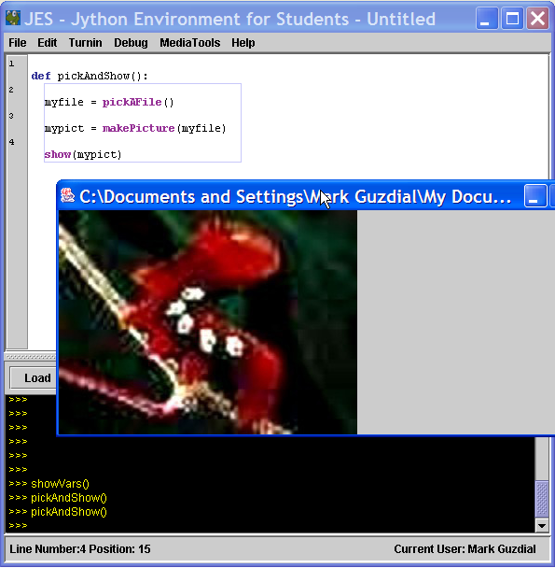
Writing a Recipe: Making Our Own Functions
To make a function, use the command def
Then, the name of the function, and the names of the input values between parentheses (“(input1)”)
End the line with a colon (“:”)
The body of the recipe is indented (Hint: Use two spaces)
That’s called a block

Slide 33
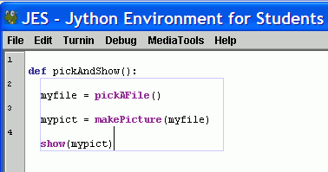
Blocking is Indicated for you in J E S
Statements that are indented the same, are in the same block.
Statements that are in the same block as where the line where the cursor is are enclosed in a blue box.

Slide 34
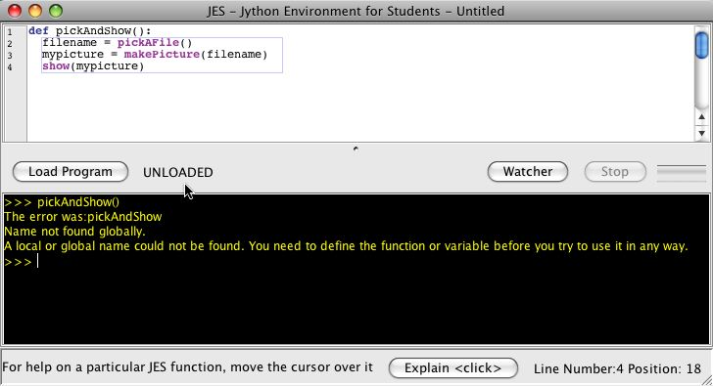
The Most Common J E S Bug: Forgetting to Load
Your function does N O T exist for J E S until you load it
Before you load it, the program is just a bunch of characters.
Loading encodes it as an executable function
Save and Save As
You must Save before Loading
You must Load before you can use your function
An “Unloaded” function doesn’t exist yet.

Slide 35
Making Functions the Easy Way
Get something working by typing commands
Enter the def command.
Copy-paste the right commands up into the recipe

Slide 36
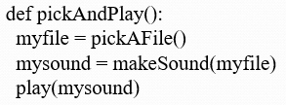
A Recipe for Playing Picked Sound Files
Note: myfile and mysound, inside pickAndPlay(), are completely different from the same names in the command area.

Slide 37
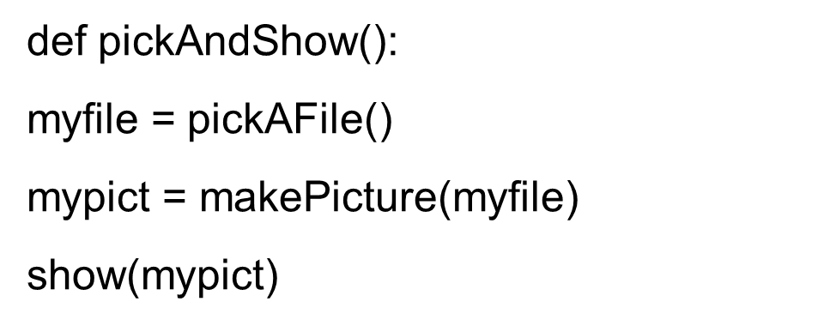
A Function for Playing Picked Picture Files

Slide 38
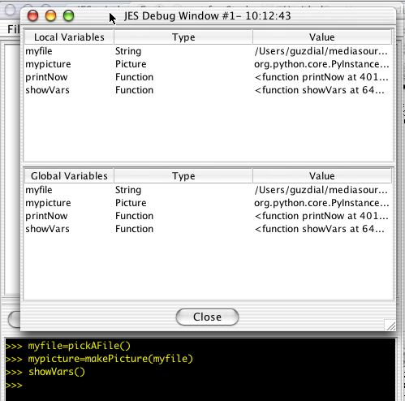
What if you Forget your Variable Names? ShowVars()

Slide 39
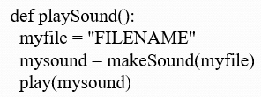
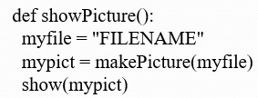
A Function for a Specific Sound or Picture
You can always replace data (a string of characters, a number, whatever) with a name (variable) that holds that data—or vice versa.
Put r in front of Windows filenames: r“C:\mediasources\pic.jpg”

Slide 40
What to do about Windows Filenames?
Python doesn’t like you to use “\” in filenames, like “C:\mediasources\barbara.jpg”
What to do?
Option #1: Put r in front of Windows filenames: r”C:\mediasources\pic.jpg”
Option #2: Use forward slashes. Python will translate it for you: “C:/mediasources/pic.jpg”

Slide 41
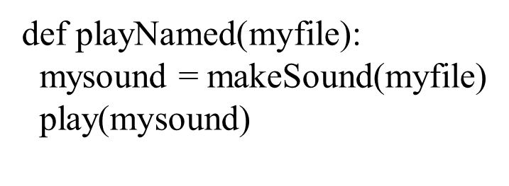
A Function that Takes Input
What functions do you need? What should be their input?
In general, have enough to do what you want, easily, understandably, and in the fewest commands.
We’ll talk more about what that means later.

Slide 42
What Can Go Wrong?
Did you use the exact same names (case, spelling)?
All the lines in the block must be indented, and indented the same amount.
Variables in the command area don’t exist in your functions, and variables in your functions don’t exist in the command area.
The computer can’t read your mind.
It will only do exactly what you tell it to do.

Slide 43
Most Important Thing to do to Pass This Class!
Do the Examples!
Try them out for yourself. Try to replicate them. Understand them
Every Week, Type in at Least Two of the Examples from Class
To understand a program means that you know why each line is there.
You will encounter all the simple-but-confusing errors early — B e f o r e you are rushing to get homework done!!

Slide 44

Copyright

